Slide 1
Life is in a Complex Mixture of Electrolytes
mostly Na⁺, K⁺, and Ca⁺⁺ Cl ⁻
Ions Come ‘in pairs’ i.e., electrically balanced neutral combinations
Na⁺
Cl⁻
0.6 nm = Channel Diameter
Electric Field is so strong that charges balance to ~10⁻¹² % , otherwise system explodes!!

Slide 2
Chemistry and Biology
are about
Chemically Specific Properties
Chemically Specific Properties are the same thing as their DEVIATION from properties of SIMPLE FLUIDS
Life Occurs in a Complex Fluid ~200 mM salt solutions mostly Sodium Na⁺, Potassium K⁺, and Calcium Ca⁺⁺ Chloride Cl ⁻

Slide 3
Stell, G. and C.G. Joslin, exact quotation:
Under physiologically appropriate conditions, it is Almost Never Valid to use Debye-Hückel Theory it is important to take proper account of Ion Size
Biophys J, 1986. 50(5): p. 855-859, emphasis Bob Eisenberg

Slide 4

Ions are in neutral groups
so properties of
Single Ions are Elusive even after 664 pages and 2604 references, properties of single ions are very hard to define
Every Ion Interacts with Everything
Electrolytes are Complex Fluids
Hünenberger & Reif (2011) Single-Ion Solvation

Slide 5

When everything interacts, we need mathematics. We need a Variational Theory of Electrolytes
Variational Mathematics:
‘Everything’ Interacts with Everything Else
Hünenberger & Reif (2011) Single-Ion Solvation

Slide 6
Mathematics describes only a little of Daily Life But Mathematics* Creates our Standard of Living
*e.g., Electricity, Integrated Circuits, Fluid Dynamics, Optics, Structural Mechanics, …..

Slide 7
Mathematics Creates our Standard of Living Mathematics replaces Trial and Error with Computation
*e.g., Electricity, Computers, Fluid Dynamics, Optics, Structural Mechanics, …..

Slide 8
Mathematics increases the Efficiency of Experimentation and Efficiency of design by orders of magnitude
We can do more with less
But you have to know which mathematics!

Slide 9
What mathematics? What is most helpful?

Slide 10
I believe
Variational Approach has a Special Value

Slide 11
Variational Approach is Always self-consistent
Allows adding components with minimal parameters

Slide 12
Scientific Discussion Converges Rapidly when Self-consistent with minimal parameters

Slide 13
Variational Approach
catalyzes
Science as a Social Process

Slide 14
Otherwise, …

Slide 15
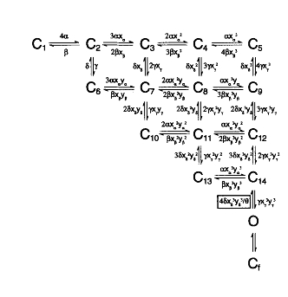
Complex Schemes produce Unresolved Discussion and Experimentation

Slide 16
Complex Schemes produce More Grants than Designs

Slide 17
Complex Schemes need to be replaced by a Variational Field Theory in my opinion Here we consider Electrolyte Solutions in general, not just infinitely dilute NaCl

Slide 18
Poisson Boltzmann does not fit Solutions of Divalent Ions
Torrie and Valleau exact quotation, emphasis Bob Eisenberg:
When the counter-ions are doubly charged … the Classical Theory Fails Altogether even for quite low concentrations and charges
Biological Solutions are Concentrated Biological Solutions Contain Divalent Ions
Torrie and Valleau , Journal of Physical Chemistry, 1982: 86: 3251-3257

Slide 19
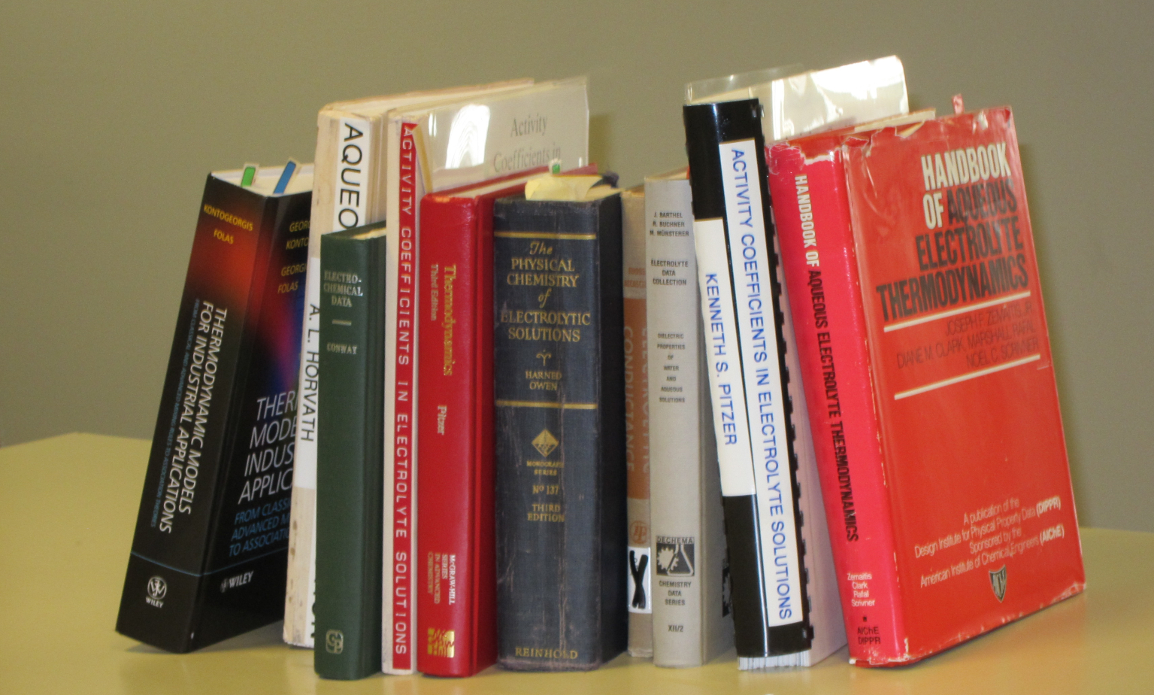
Good Data

Slide 20
Good Data
Compilations of Specific Ion Effect
>139,175 Data Points [Sept 2011] on-line IVC-SEP Tech Univ of Denmark http://www.cere.dtu.dk/Expertise/Data_Bank.aspx
2. Kontogeorgis, G. and G. Folas, 2009: Models for Electrolyte Systems. Thermodynamic John Wiley & Sons, Ltd. 461-523.
3. Zemaitis, J.F., Jr., D.M. Clark, M. Rafal, and N.C. Scrivner, 1986, Handbook of Aqueous Electrolyte Thermodynamics.
American Institute of Chemical Engineers
4. Pytkowicz, R.M., 1979, Activity Coefficients in Electrolyte Solutions. Vol. 1. Boca Raton FL USA: CRC. 288.

Slide 21
Bad Theory even without flow
“It is still a fact that over the last decades, it was easier to fly to the moon than to describe the free energy of even the simplest salt solutions beyond a concentration of 0.1M or so.”
Kunz, W. "Specific Ion Effects"
World Scientific Singapore, 2009; p 11.

Slide 22
Ions in Water are the Liquid of Life
They are not ideal solutions
Everything Interacts
with Everything
For Modelers and Mathematicians
Tremendous Opportunity for Applied Mathematics
because
‘law’ of mass action assumes nothing interacts Chun Liu’s Energetic Variational Principle
EnVarA

Slide 23
Everything Interacts
Mathematics of Chemistry
must deal
Naturally
with Interactions
‘Law of Mass Action’ assumes nothing interacts
So this is a great opportunity for new mathematics and applications!

Slide 24
Everything Interacts
Mathematics of Chemistry
must deal
Naturally
with Interactions
‘Law of Mass Action’ assumes Nothing Interacts
So this is a great opportunity for new mathematics and applications!

Slide 25
Where to start?
Why not compute all the atoms?

Slide 26
^{Multi-Scale Issues}
Journal of Physical Chemistry C (2010 )114:20719, invited review
Computational Scale | Biological Scale | Ratio
Time 10⁻¹⁵ sec | 10⁻⁴ sec | 10¹¹
Space 10⁻¹¹ m | 10⁻⁵ m | 10⁶
Spatial Resolution |  | 10¹²
Solute Concentration | 10⁻¹¹ to 10¹ M | 10¹²
Three Dimensional (10⁴)³
Biological Scales Occur Together
so must be
Computed Together
This may be impossible in simulations

Slide 27
Force Fields are Calibrated Ignoring Interactions with ions
but
Chemically Specific Properties come from Interactions in Ionic Solutions
Life occurs in Interacting Solutions

Slide 28
Molecular Dynamics Simulations almost always Assume No Interactions
Real Solutions Always Have Interactions
Electric Field
Every ion interacts with every other ion
through the
Ionic Atmosphere
Ionic atmosphere is crowded around the center
Steric Effects

Slide 29
Molecular Dynamics Force Fields are Calibrated assuming no interactions with concentrations
Force Fields must be REcalibrated in each Biological Solution
Just ask the author(s) of CHARMM
Chemically Specific Properties of Ionic Solutions come from Interactions
Ions in Water are the Liquid of Life. They are not ideal solutions

Slide 30
Calibration is Hard Work
Force Fields must be RE-calibrated in each Biological Solution to verify equilibrium potentials (chemical potentials)
Fitting Real Experiments requires Accurate Chemical Potentials in mixtures Channels are Identified by Equilibrium Potentials
If simulations are uncalibrated, even the type of the channel is unknown
like Ringer Solution, with Ca²⁺

Slide 31
Uncalibrated Simulations will not make devices that actually work

Slide 32
In my opinion
‘New’ Mathematics is needed to deal with the INTERACTIONS that make ionic solutions non-ideal
and create the CHEMICAL SPECIFICITY of life
Biological Theory and Molecular Dynamics Simulations almost always assume ideal solutions

Slide 33
No theory is available for Mixtures of Ions
In my opinion
‘New’ Mathematics is needed to deal with the INTERACTIONS that make ionic solutions non ideal
and that can create the CHEMICAL SPECIFICITY of life

Slide 34
No theory is available for Flow
of any kind.
In my opinion
‘New’ Mathematics is needed to deal with the INTERACTIONS that make ionic solutions non ideal
and that can create the CHEMICAL SPECIFICITY of life

Slide 35
No theory is available for Brownian Motion of Ions
Brownian Motion theory is for UNcharged particles. Brownian Motion theory ignores Interactions
In my opinion
‘New’ Mathematics is needed to deal with the INTERACTIONS that make ionic solutions non ideal
and that can create the CHEMICAL SPECIFICITY of life

Slide 36
Where to start?
Mathematically ?
Physically ?

Slide 37
Where to start?
‘Law of Mass Action’
must be Replaced by a
Variational Principle

Slide 38
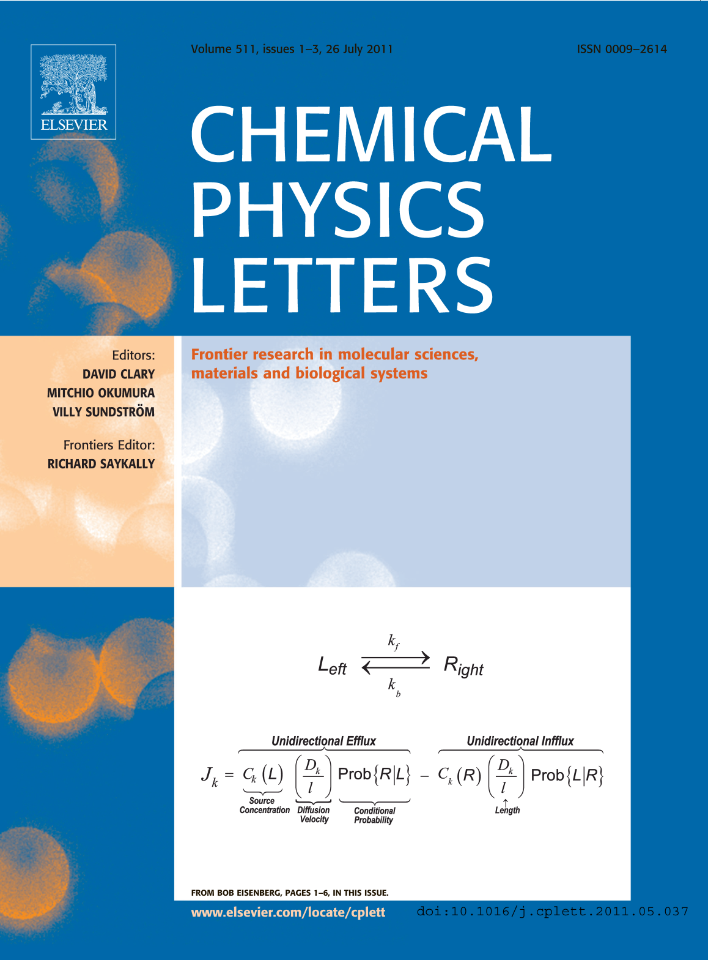
‘New’ Mathematics of Interactions
‘Law’ of Mass Action including Interactions
Variational Approach
EnVarA
Conservative
Dissipative
From Bob Eisenberg p. 1-6, in this issue

Slide 39
Replacement of “Law of Mass Action” is Feasible for Electrolyte Solutions

Slide 40
Replacement of “Law of Mass Action” is Feasible for Electrolyte Solutions because
Chemically Specific Properties
come from Interactions mostly from
Finite Size Effects

Slide 41
Chemically Specific Properties
of ions (e.g. activity = free energy per mole) are known to come from interactions of their Diameter and Charge
and dielectric ‘constant’ of ionic solution
Atomic Detail
‘Primitive Implicit Solvent Model’ learned from Doug Henderson, J.-P. Hansen, Stuart Rice, Monte Pettitt among others … Thanks!

Slide 42
Central Result of Physical Chemistry
Electrolytes in a solution are a Highly Compressible Plasma
of Interacting Spherical Particles
although the Liquid itself is Incompressible
Debye-Hückel and Poisson-Nernst-Planck PNP cannot describe these interactions of spheres
Learned from Douglas Henderson, J.-P. Hansen, and Stuart Rice…Thanks!

Slide 43
Variational Principles Deal with Interactions Consistently and Automatically
Chun Liu, with YunKyong Hyon, and Bob Eisenberg
EnVarA
New Component (or Scale) implies
New Field Equations (Euler Lagrange)
by
Algebra Alone
No new Assumptions

Slide 44
Energetic Variational Approach EnVarA Chun Liu, Rolf Ryham, Yunkyong Hyon, and Bob Eisenberg
Mathematicians and Modelers: two different ‘partial’ variations
written in one framework, using a ‘pullback’ of the action integral
Action Integral, after pullback
Rayleigh Dissipation Function
Composite Variational Principle
Euler Lagrange Equations
Field Theory of Ionic Solutions
that allows boundary conditions and flow and deals with Interactions of Components self-consistently

Slide 45
Variational Analysis of Ionic Solution EnVarA
Generalization of Chemical Free Energy
Dielectric Coefficient
from Poisson Eq.
Number Densities
Lagrange Multiplier
Eisenberg, Hyon, and Liu

Slide 46
EnVarA Dissipation Principle for Ions
Number Density
time
Permanent Charge of protein
Hard Sphere Terms
Thermal Energy
valence
proton charge
c_{i} number density; thermal energy; D_{i} diffusion coefficient; n negative; p positive; z_{i} valence
Eisenberg, Hyon, and Liu

Slide 47
Field Equations with Lennard Jones Spheres
Non-equilibrium variational field theory EnVarA
Nernst Planck Diffusion Equation
for number density c_{n} of negative n ions; positive ions are analogous
Diffusion Coefficient
Thermal Energy
Coupling Parameters
Ion Radii
Number Densities
Poisson Equation
Dielectric Coefficient
valence
proton charge
Eisenberg, Hyon, and Liu
Permanent Charge of Protein

Slide 48
Energetic Variational Approach EnVarA across biological scales: molecules, cells, tissues developed by Chun Liu with
(1) Hyon, Eisenberg Ions in Channels
(2) Horng, Lin, Lee Ions in Channels
(3) Bezanilla, Hyon, Eisenberg Conformation Change of Voltage Sensor
(4) Ryham, Cohen Virus fusion to Cells
(5) Mori, Eisenberg Water flow in Tissues
Multiple Scales
creates a new Multiscale Field Theory of Interacting Components
that allows boundary conditions and flow and deals with Ions in solutions self-consistently

Slide 49
Energetic Variational Approach developed by Chun Liu
Preliminary Results
demonstrate
Feasibility
for
Classical Unsolved Problems

Slide 50
Eisenberg, Hyon, and Liu

Slide 51
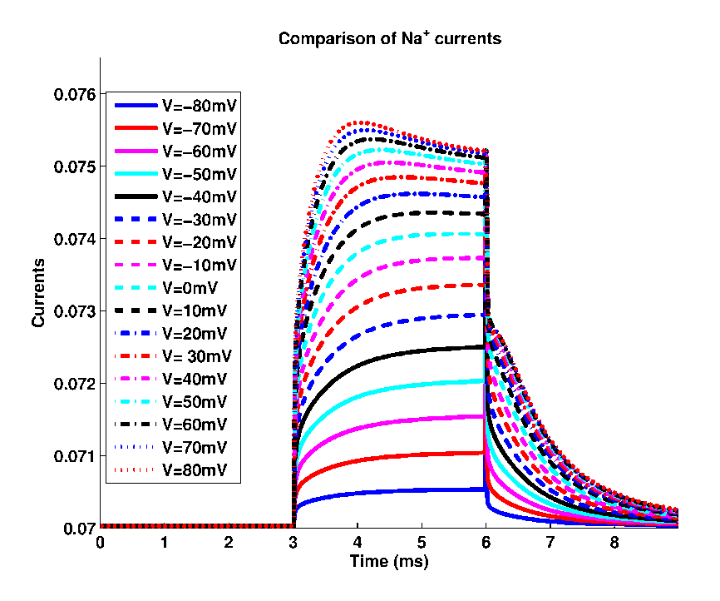
Nonequilibrium Computations
with Variational Field Theory
EnVarA
Binding Curves
Current Voltage Time Curves

Slide 52
Energetic Variational Approach EnVarA
New mechanisms* (e.g., active transport)
can be added
*if they define an energy and its variation Energy defined by simulations or theories or experiments is OK
Full micro/macro treatment is needed for an Atomic Model, with closure, as in liquid crystals
Eisenberg, Hyon, and Liu

Slide 53
Energetic Variational Analysis EnVarA Chun Liu, Yunkyong Hyon and Bob Eisenberg
New Interpretations likely to be Controversial but Quantitative and Testable

Slide 54
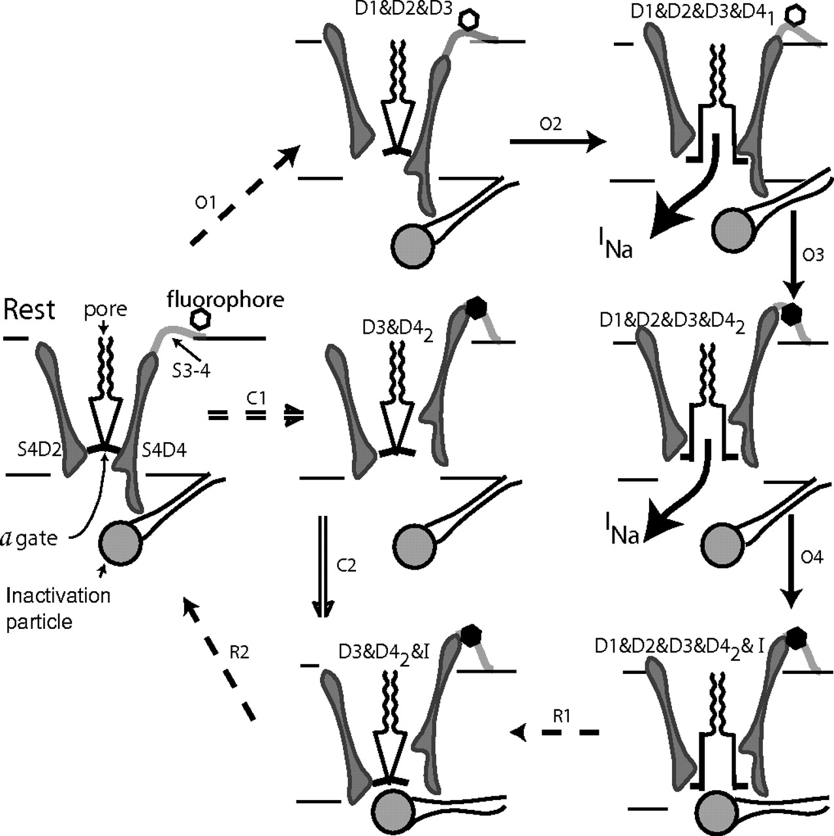
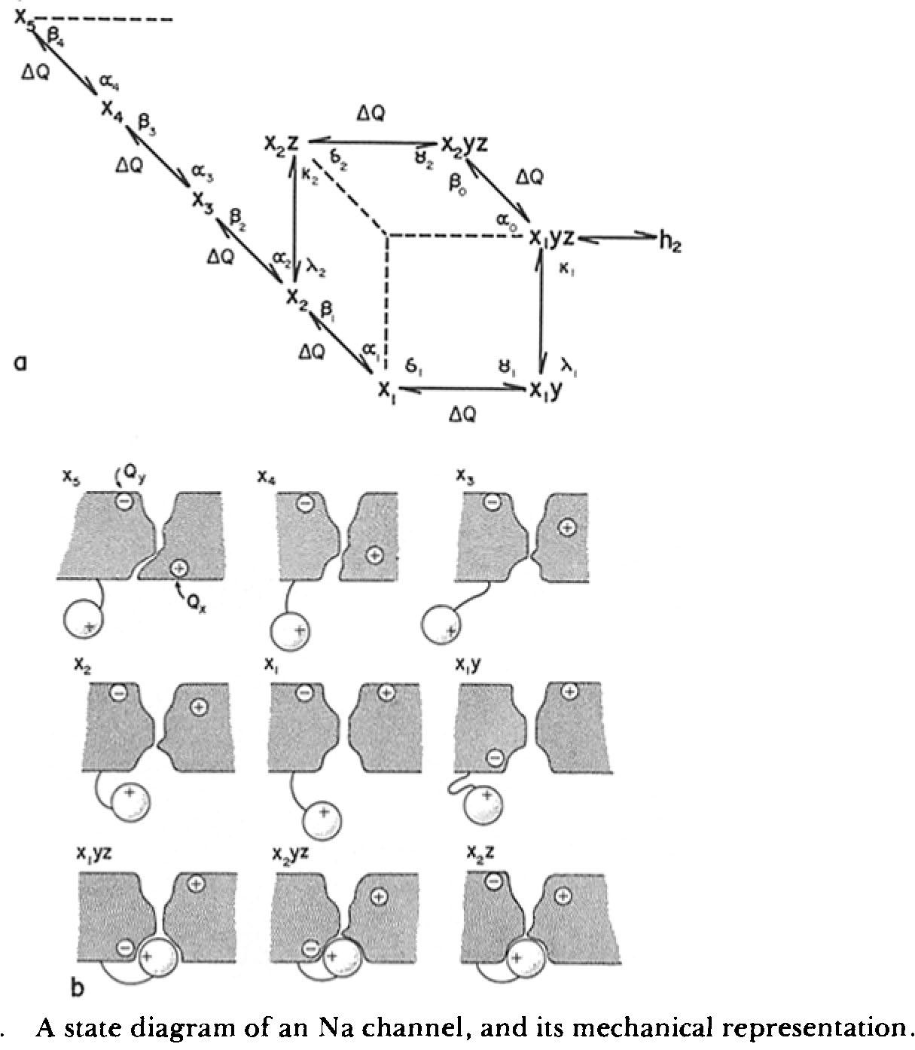
Variational Approach is needed to Add Components and Mechanisms with Minimal Confusion
in my opinion

Slide 55
.
EnVarA here deals with Reduced Models
Reduced Models are Needed
Reduced Models are Device Equations
like Input Output Relations of Engineering Systems.
The device equation is the mathematical
statement of how the system works.
Device Equations describe ‘Slow Variables’
found in some complicated systems

Slide 56
.
Finding the reduced model,
checking its validity,
estimating its parameters, and their effects, are all part of the
Inverse Problem
‘Reverse Engineering’ of Specificity

Slide 57
Biology is Easier than Physics
Reduced Models Exist*
for important biological functions
or the
Animal would not survive
to reproduce
*Evolution provides the existence theorems and uniqueness conditions so hard to find in theory of inverse problems

Slide 58
Biology is Easier than Physics
Biology Says a Simple Model Exists
Existence of Life
Implies Existence of a Simple Model

Slide 59
Existence of Life
implies the
Existence of Robust Multiscale Models
Biology Says there is a Simple Model of Specificity
and other vital functions

Slide 60
Reduced models are the adaptation created by evolution to perform the biological function of selectivity
Inverse Methods are needed to
Establish the Reduced Model
and its Parameters

Slide 61
Inverse Problems
Badly posed, simultaneously over and under determined.
Exact choice of question and data are crucial
Underlying Math Problem (with DFT, noise and systematic error) has actually been solved
using Tikhonov Regularization as in the Inverse Problem of a Blast Furnace Burger, Eisenberg and Engl (2007) SIAM J Applied Math 67: 960-989

Slide 62
Modelers and Mathematicians, Bioengineers: this is reverse engineering
Inverse Problems Many answers are possible Central Issue
Which answer is right?
Underlying Math Problem (with DFT, noise and systematic error) has actually been solved
using Tikhonov Regularization as in the Inverse Problem of a Blast Furnace Burger, Eisenberg and Engl (2007) SIAM J Applied Math 67: 960-989

Slide 63
How does the Channel control Selectivity?
Inverse Problems: many answers possible
Central Issue
Which answer is right?
Key is
ALWAYS
Large Amount of Data
from
Many Different Conditions
Almost too much data was available for Burger, Eisenberg and Engl (2007) SIAM J Applied Math 67: 960-989

Slide 64
Solving Inverse Problems depends on
Fitting Large Amounts of Data
from many Different Techniques

Slide 65
Dealing with Different Experimental Traditions is an unsolved social problem
What was measured?
With what setup?
With what assumptions?

Slide 66
Ion Channels are a good test case
because I know the experimental tradition
Channels are also Biologically Very Important
Help! Do not yet have collaboration with someone who knows the EXPERIMENTAL literature of Electrolyte Solutions.

Slide 67
Ion Channels are a good Test Case
Simple Physics (Electrodiffusion)
Single Structure (once open)
Simple Theory is Possible and Reasonably Robust because Channels are Devices
with well defined Inputs, Outputs and Power Supplies
Channels are also Biologically Very Important

Slide 68
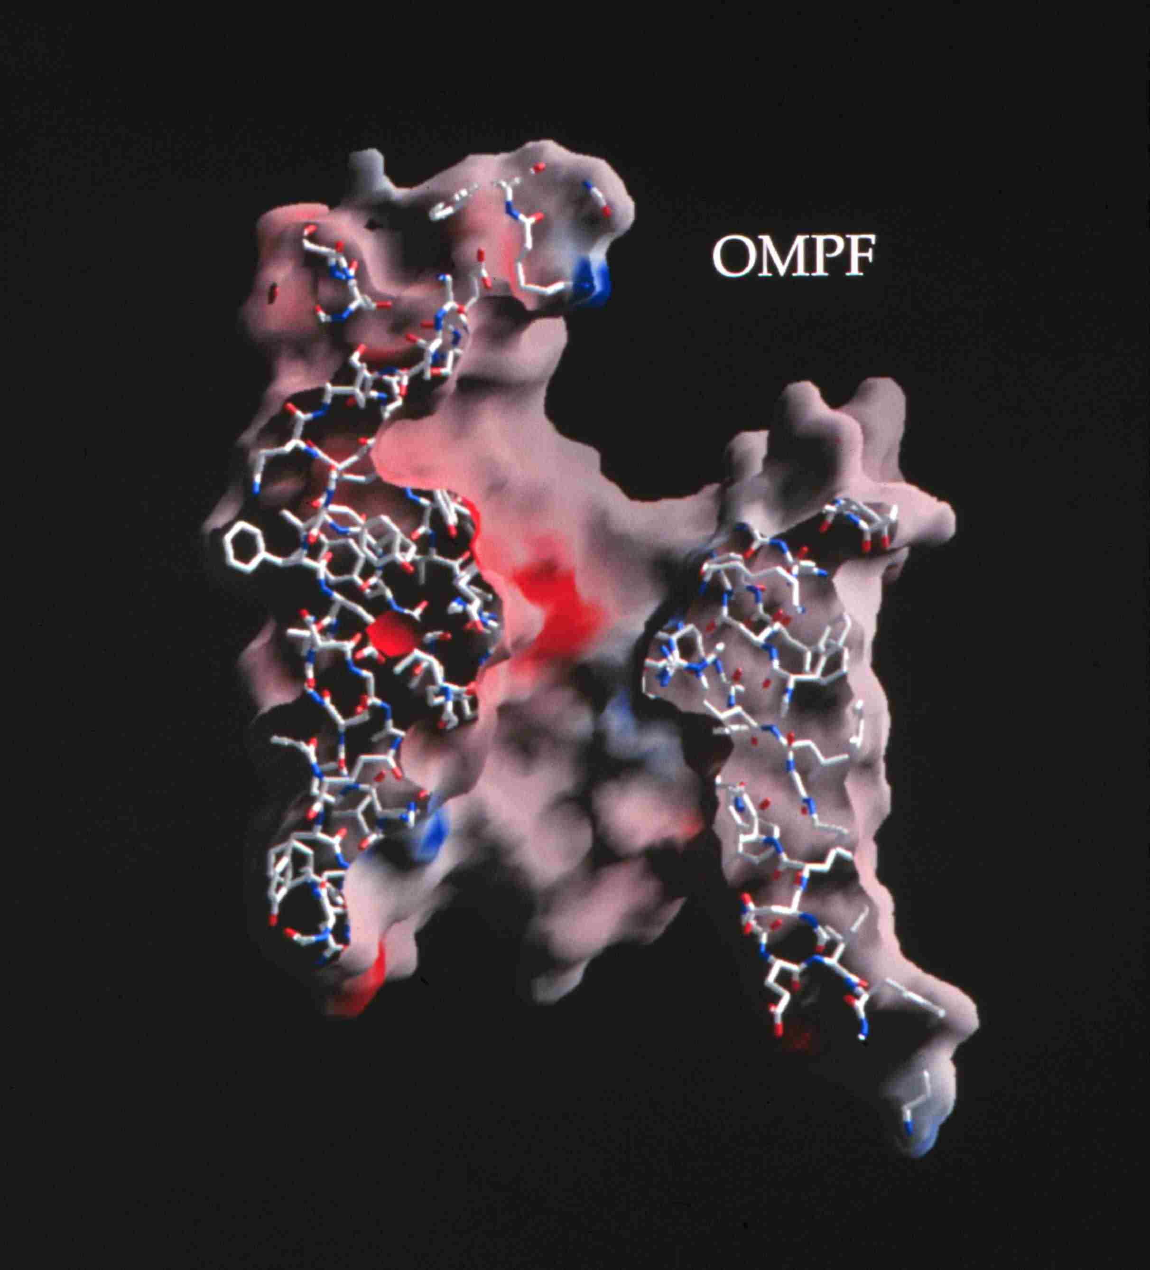
Ion Channels are the Valves of Cells Ion Channels are Devices* that Control Biological Function
Selectivity
Different Ions carry Different Signals
Ions in Water are the
Liquid of Life
Hard Spheres
Na⁺
Chemical Bonds are lines
Surface is Electrical Potential
Red is negative (acid)
Blue is positive (basic)
Ca⁺⁺
K⁺
+
Figure of ompF porin by Raimund Dutzler
0.7 nm = Channel Diameter
~30 Å
3 Å
*Devices as defined in engineering , with inputs and outputs, and power supplies.
Notes:
MD scales are very different

Slide 69
Natural nano-valves* for atomic control of biological function
Ion Channels are Biological Devices
Ion channels coordinate contraction of cardiac muscle, allowing the heart to function as a pump
Ion channels coordinate contraction in skeletal muscle
Ion channels control all electrical activity in cells Ion channels produce signals of the nervous system
Ion channels are involved in secretion and absorption in all cells: kidney, intestine, liver, adrenal glands, etc.
Ion channels are involved in thousands of diseases and many drugs act on channels
Ion channels are proteins whose genes (blueprints) can be manipulated by molecular genetics
Ion channels have structures shown by x-ray crystallography in favorable cases
K⁺
~30 Å
*nearly pico-valves: diameter is 400 – 900 picometers
Notes:
Ion channels are a class of Proteins that reside in the cell membrane of all biological cells. Each channel protein consists of a chain of amino acids folded in such a way that it forms a nanoscopic water-filled tunnel through which ions can flow to cross the otherwise impermeable membrane.
Every ion channel carries a strong and steeply varying distribution of permanent charge, which depends on the particular combination of channel and prevalent physiological conditions. This permanent charge has an important role in determining the current-voltage characteristics of the open channel.
Many channels are designed by nature to selectively transmit or block a particular ion species. This allows only one type of ion to cross the membrane even though other ions may be present in much higher concentrations. Many channels can also open and close by mechanical or other means, switching on and off like electronic devices.
From a physiological point of view ion channels are essential for maintaining the correct internal ion composition necessary for cell survival and function. They directly control electrical signaling in the nervous system, muscle contraction, and the delivery of many clinical drugs. Malfunctioning channels cause or are associated with many diseases.
From a device point of view, ion channels can be thought of as elements in an electrical circuit, behaving like resistors, diodes or batteries depending on the specific channel and environmental factors. By replacing or deleting one or more of the amino acids many channels can be mutated, altering the charge distribution along the channel. Designing and engineering channels with specific conductances and selectivities, and incorporating them into bio-devices, is a real possibility.

Slide 70

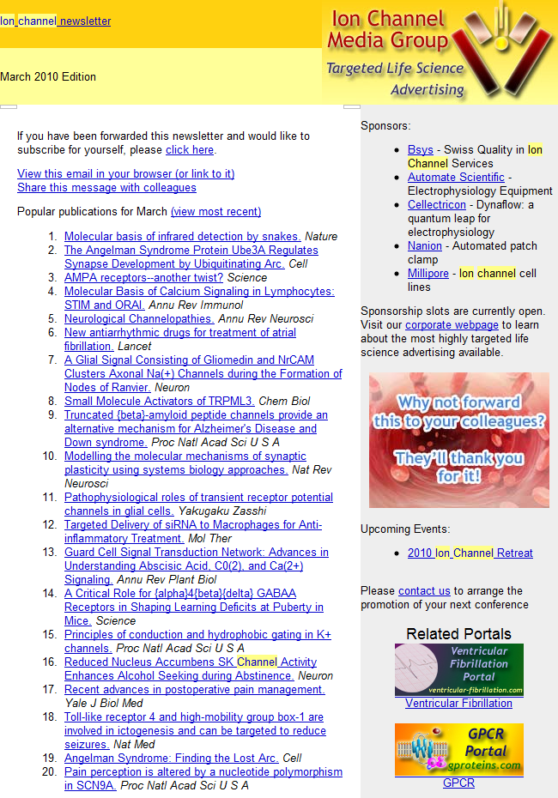
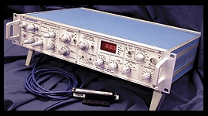
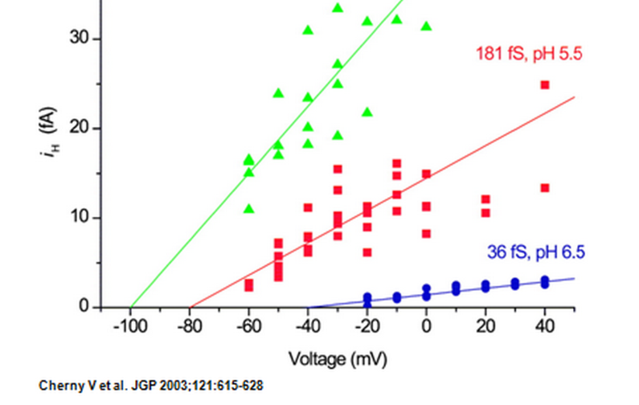
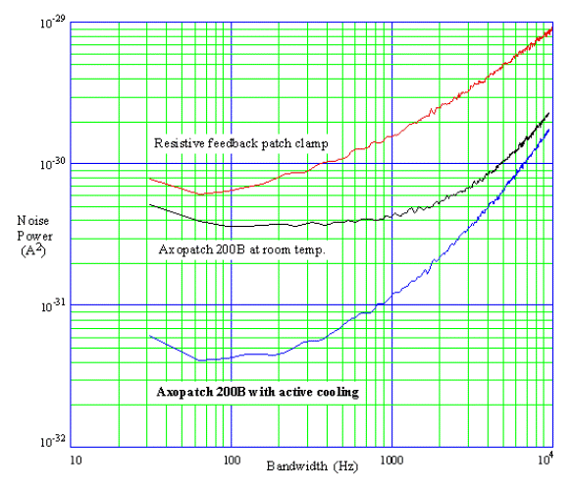
Thousands of Molecular Biologists Study Channels every day, One protein molecule at a time This number is not an exaggeration. We have sold >10,000 AxoPatch amplifiers
Ion Channel Monthly
AxoPatch 200B
Femto-amps
(10⁻¹⁵ A)

Slide 71
Channel Structure Does Not Change
once the channel is open
Current vs. time
Amplitude vs. Duration
Open
Closed
Open Amplitude, pA
5 pA
100 ms
Open Duration /ms
Lowpass Filter = 1 kHz Sample Rate = 20 kHz
Typical Raw Single Channel Records
Ca²⁺ Release Channel of Inositol Trisphosphate Receptor: slide and data from Josefina Ramos-Franco. Thanks!

Slide 72
Channels are Selective Different Ions Carry Different Signals through Different Channels
ompF porin
Ca⁺⁺
Na⁺
K⁺
3 Å
+
0.7 nm = Channel Diameter
Diameter matters
In ideal solutions K⁺ = Na⁺
~30 Å
Flow time scale is 0.1 msec to 1 min
Figure of ompF porin by Raimund Dutzler

Slide 73
Channels are Selective because Diameter Matters
Ions are NOT Ideal
Potassium K⁺ = Na⁺ Sodium
/
K⁺
Na⁺
3 Å
Ideal Ions are Identical
if they have the same charge
In ideal solutions K⁺ = Na⁺

Slide 74
Channels are Selective
Different Types of Channels
use
Different Types of Ions for
Different Information

Slide 75
Goal:
Understand Selectivity
well enough to Fit Large Amounts of Data
from many solutions and concentrations and to
Make a Calcium Channel
Atomic Scale
atomic × 10¹⁰ = MACRO
MACRO Scale

Slide 76
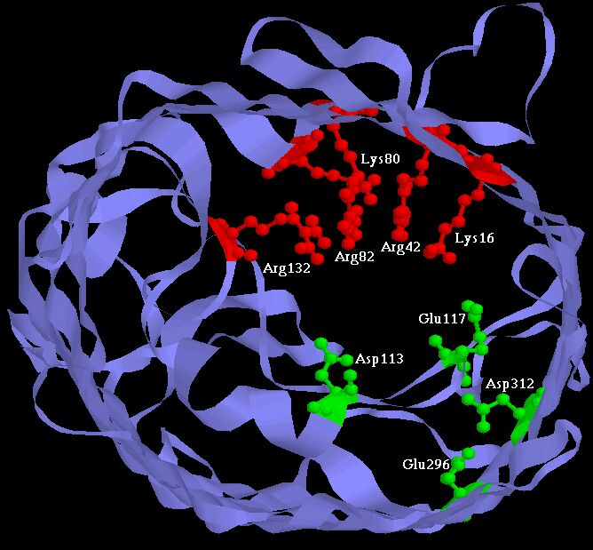
Experiments have built Two Synthetic Calcium Channels
Atomic Scale
Mutants of ompF Porin
Designed by Theory
Glutathione derivatives
MUTANT ─ Compound
Calcium selective
Unselective
Wild Type
As density of permanent charge increases, channel becomes calcium selective E_{rev} → E_{Ca} in 0.1M 1.0 M CaCl₂
Macro Scale
||
built by Henk Miedema, Wim Meijberg of BioMade Corp.,Groningen, Netherlands
Miedema et al, Biophys J 87: 3137–3147 (2004)

Slide 77
Comparison with Experiments shows
Potassium K⁺ Sodium Na⁺
Must include Biological Adaptation!
Working Hypothesis
Biological Adaptation is
Crowded Ions and Side Chains

Slide 78
Physical basis of function
Active Sites of Proteins are Very Charged
7 charges ~ 20 M net charge
= 1.2×10²² cm⁻³
liquid Water is 55 M solid NaCl is 37 M
OmpF Porin
Ions are Crowded
Hard Spheres
Na⁺
+
+
+
+
+
K⁺
Ca²⁺
Na⁺
-
-
-
K⁺
-
Induced Fit of Side Chains
4 Å
Selectivity Filters and Gates of Ion Channels
are
Active Sites
Figure adapted from Tilman Schirmer

Slide 79
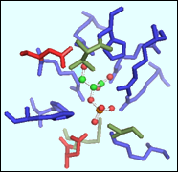
Ionizable Residues Density = 22 M
 |  | #AA | MS_A^3 | CD_MS+ | CD_MS- | CD_MSt
EC1:Oxidoreductases | Average | 47.2 | 1,664.74 | 7.58 | 2.82 | 10.41
 | Median | 45.0 | 1,445.26 | 6.12 | 2.49 | 8.70
EC2:Transferases | Average | 33.8 | 990.42 | 13.20 | 6.63 | 19.83
 | Median | 32.0 | 842.43 | 8.18 | 6.71 | 14.91
EC3:Hydrolases | Average | 24.3 | 682.88 | 13.14 | 13.48 | 26.62
 | Median | 20.0 | 404.48 | 11.59 | 12.78 | 23.64
EC4:Lyases | Average | 38.2 | 1,301.89 | 13.16 | 6.60 | 19.76
 | Median | 28.0 | 822.73 | 10.81 | 4.88 | 16.56
EC5:Isomerases | Average | 31.6 | 1,027.15 | 24.03 | 11.30 | 35.33
 | Median | 34.0 | 989.98 | 9.05 | 7.76 | 16.82
EC6:Ligases | Average | 44.4 | 1,310.03 | 9.25 | 9.93 | 19.18
 | Median | 49.0 | 1,637.98 | 8.32 | 7.95 | 17.89
 |  | #AA | MS_A^3 | CD_MS+ | CD_MS- | CD_MSt
Total n= 150 | Average | 36.6 | 1,162.85 | 13.39 | 8.46 | 21.86
 | Median | 33.0 | 916.21 | 8.69 | 7.23 | 16.69
EC#: Enzyme Commission Number based on chemical reaction catalyzed
#AA: Number of residues in the functional pocket
MS_A^3: Molecular Surface Area of the Functional Pocket (Units Angstrom^3)
CD_MS+: Base Density (probably positive)
CD_MS-: Acid Density (probably negative)
CD_MSt: Total Ionizable density
Jimenez-Morales,
Liang,
Eisenberg

Slide 80
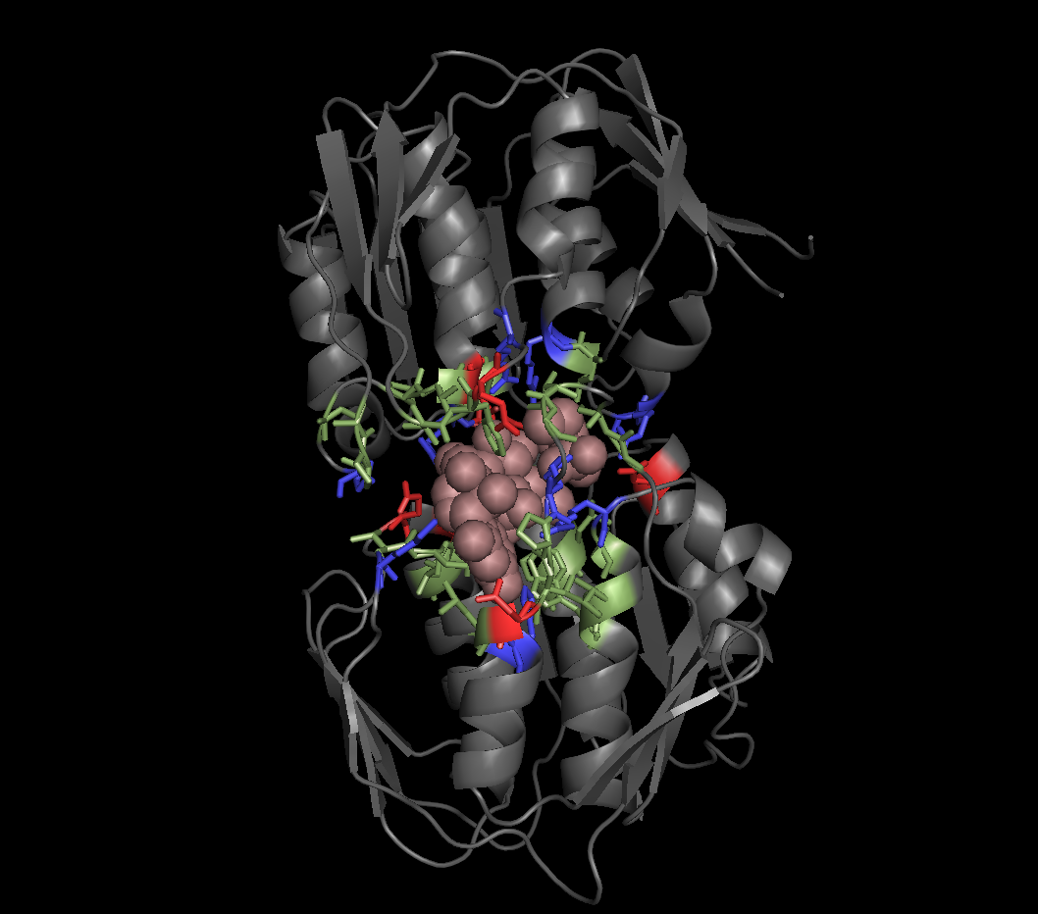
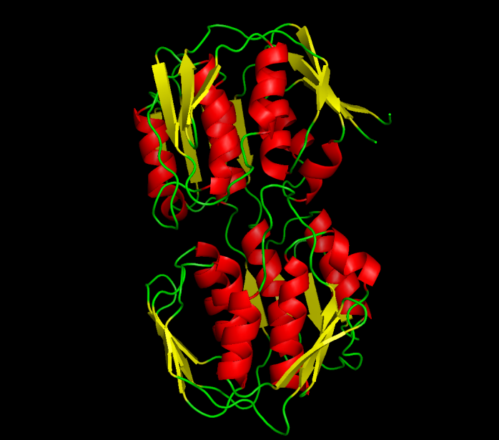
Example:
UDP-N-ACETYLGLUCOSAMINE ENOLPYRUVYL TRANSFERASE (PDB:1UAE)
Functional Pocket Molecular Surface Volume: 1462.40 A³
Density : 19.3 Molar (11.3 M+. 8 M-)
EC2: TRANSFERASES Average Ionizable Density: 19.8 Molar
Crowded
Green: Functional pocket residues
Blue: Basic = Probably Positive = R+K+H
Red: Acid = Probably Negative = E + Q
Brown URIDINE-DIPHOSPHATE-N-
ACETYLGLUCOSAMINE
Jimenez-Morales, Liang, Eisenberg

Slide 81
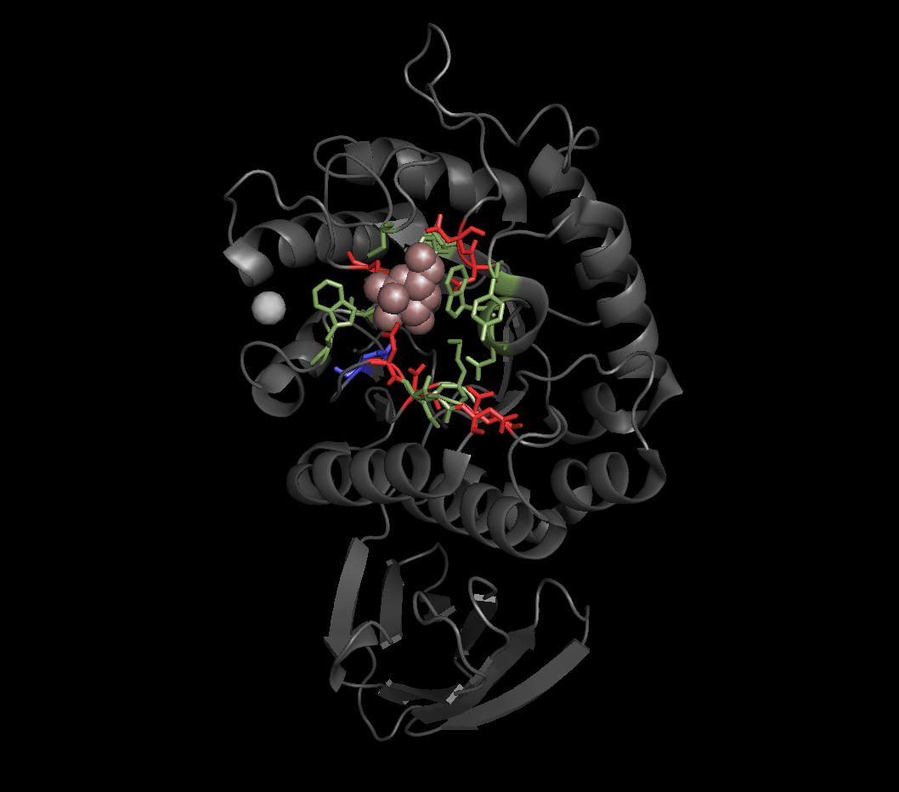
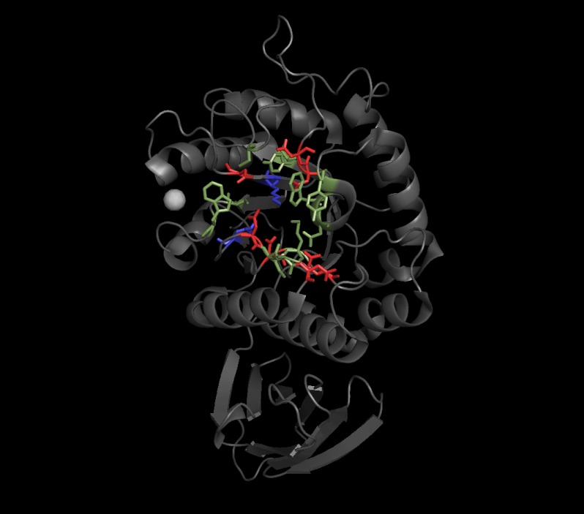
Example:
ALPHA-GALACTOSIDASE (PDB:1UAS)
Functional Pocket Molecular Surface Volume: 286.58 A³
Density : 52.2 Molar (11.6 M+. 40.6 M-)
EC3: HYDROLASES Average Ionizable Density: 26.6 Molar
Crowded
Green: Functional pocket residues
Blue: Basic = Probably Positive = R+K+H
Red: Acid = Probably Negative = E + Q
Brown ALPHA D-GALACTOSE
Jimenez-Morales, Liang, Eisenberg

Slide 82
Ions in Water are the Liquid of Life
They are not ideal solutions
Everything Interacts
with Everything
For Modelers and Mathematicians
Tremendous Opportunity for Applied Mathematics Chun Liu’s Energetic Variational Principle
EnVarA

Slide 83
Working Hypothesis
Biological Adaptation is
Crowded Ions and Side Chains
Everything interacts
‘law’ of mass action assumes nothing interacts

Slide 84
Energetic Variational Analysis EnVarA being developed by Chun Liu Yunkyong Hyon and Bob Eisenberg
creates a Field Theory of Ionic Solutions
that allows boundary conditions and flow and deals with Interactions of Components Self-consistently

Slide 85
Great Opportunity for New Mathematics and Its Applications
‘Law’ of Mass Action including Interactions
Variational Approach
EnVarA
Conservative
Dissipative
From Bob Eisenberg p. 1-6, in this issue

Slide 86
The End
Any Questions?

Slide 89
Best Evidence is from the
RyR Receptor
Gillespie, Meissner, Le Xu, et al, not Bob Eisenberg
● More than 120 combinations of solutions & mutants
● 7 mutants with significant effects fit successfully

Slide 90
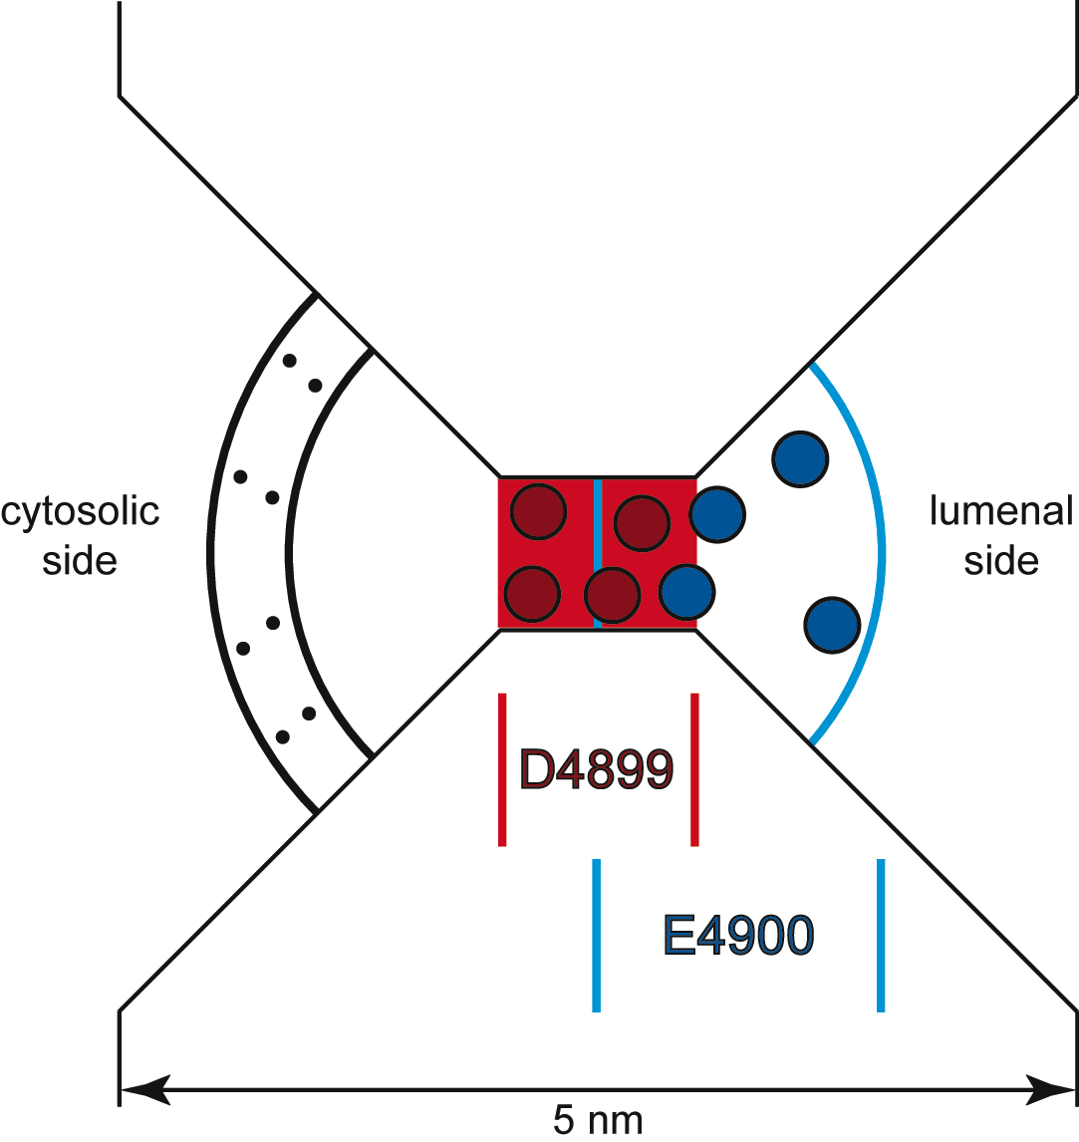
The Geometry
Selectivity Filter
is 10 Å long and 8 Å in diameter
confines four D4899 negative amino acids.
Four E4900 positive amino acids are on lumenal side, overlapping D4899.
Cytosolic distributed charge
Protein
Cytoplasm
Lumen
Protein
D. Gillespie et al., J. Phys. Chem. 109, 15598 (2005).

Slide 91
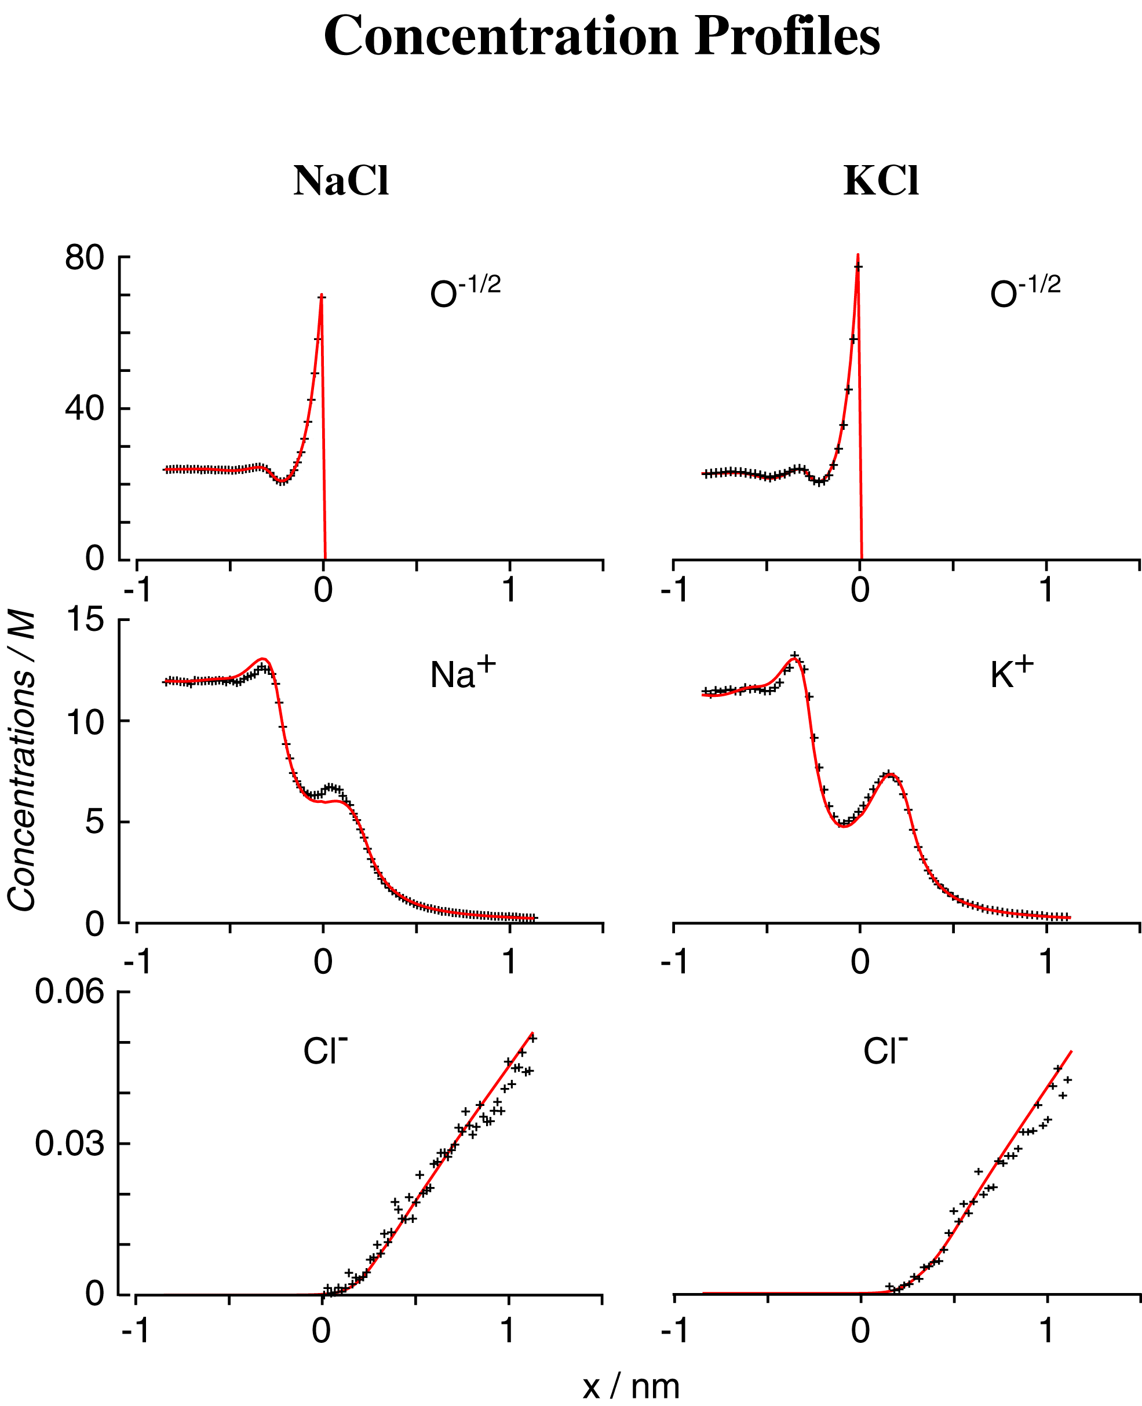
DFT/PNP vs Monte Carlo Simulations
Concentration Profiles
Misfit
Nonner, Gillespie, Eisenberg

Slide 92
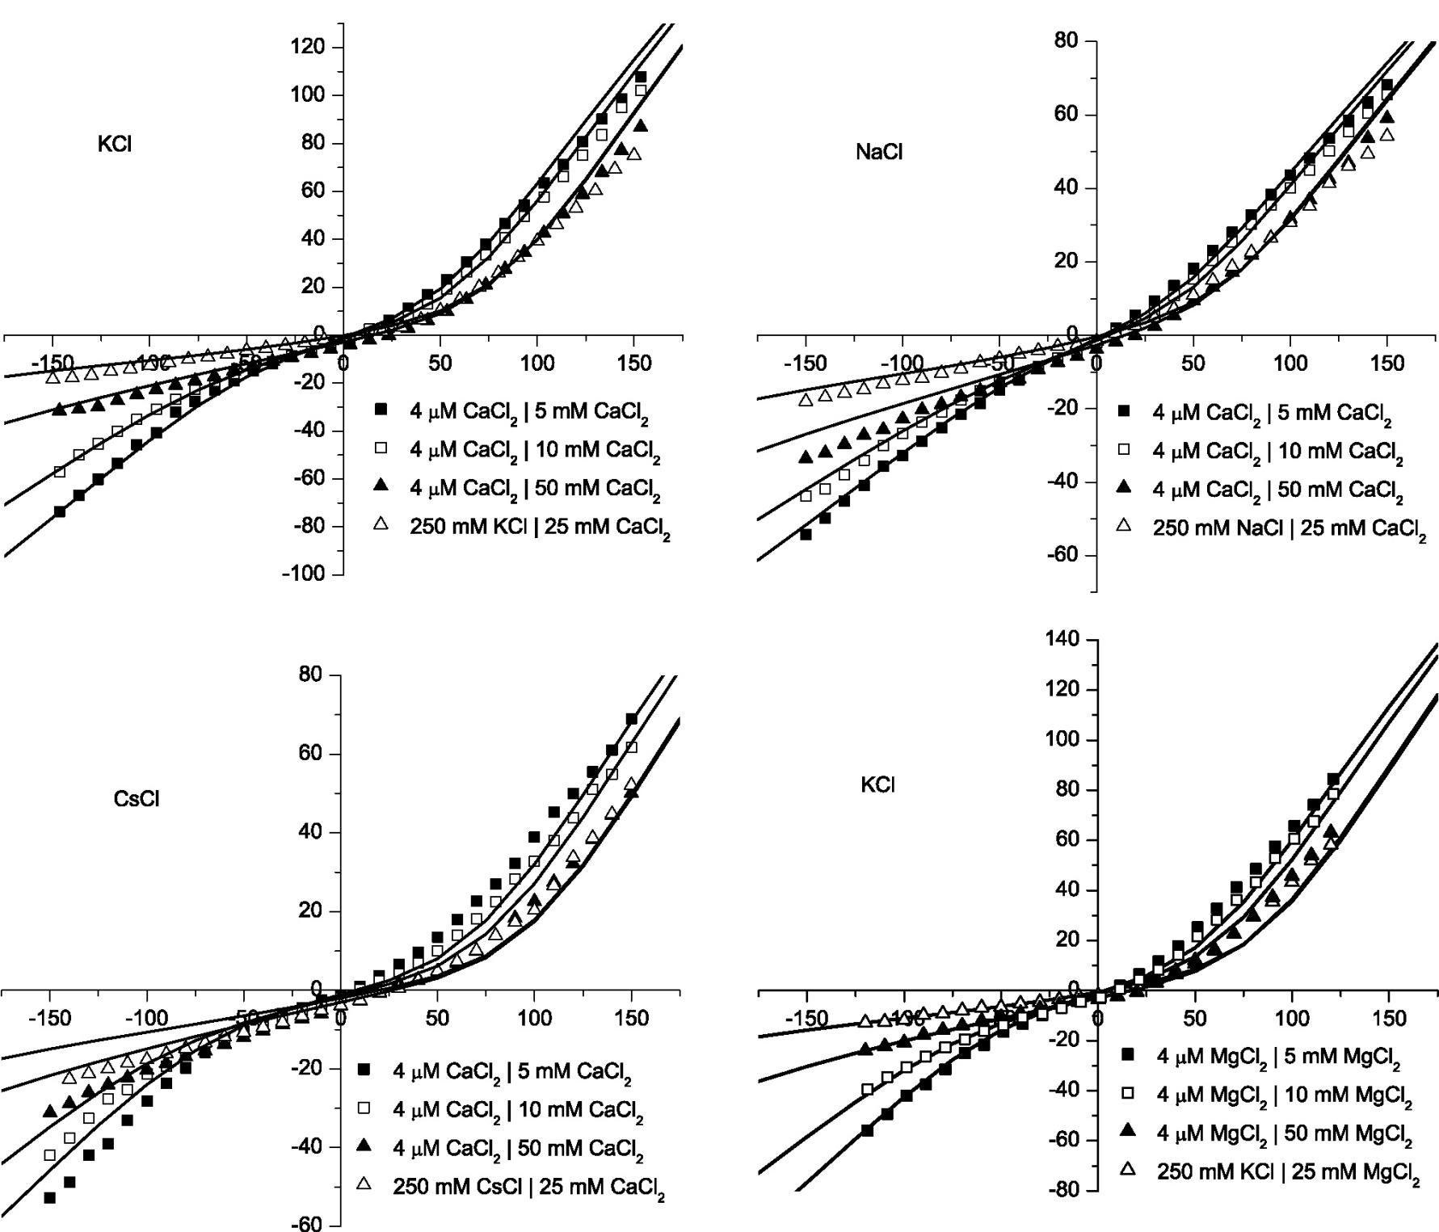
Divalents
Gillespie, Meissner, Le Xu, et al
KCl
CaCl₂
NaCl
CaCl₂
Error < 0.1 kT/e
Misfit
2 kT/e
CsCl
CaCl₂
KCl
MgCl₂
Misfit

Slide 93
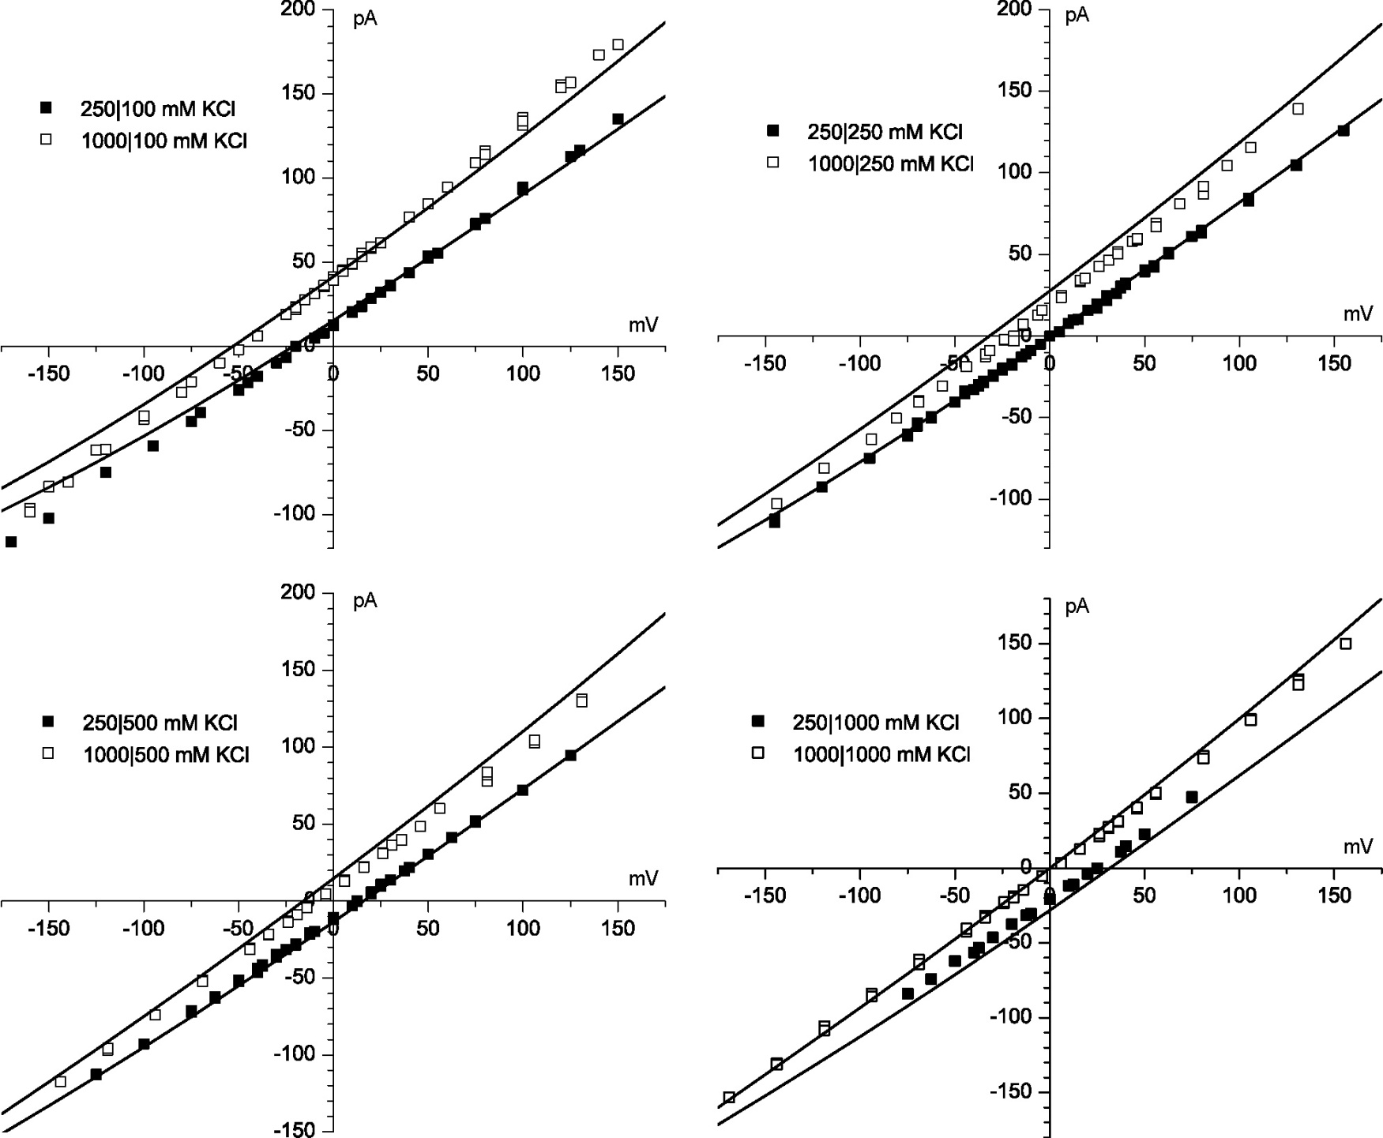
KCl
Gillespie, Meissner, Le Xu, et al
4 kT/e
Error < 0.1 kT/e
Misfit

Slide 94
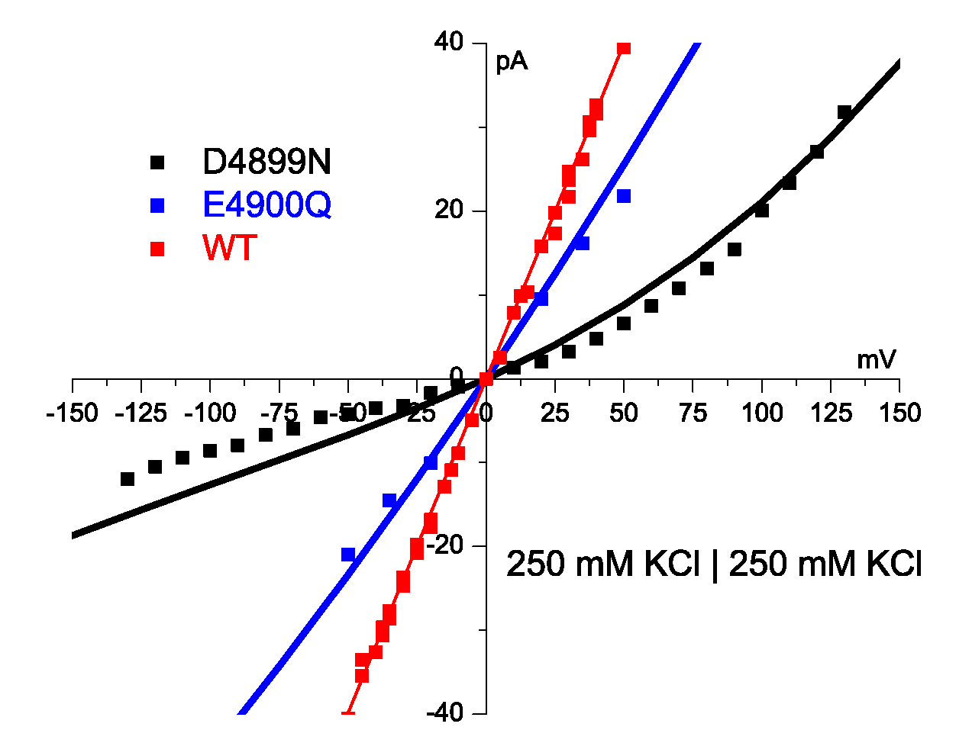
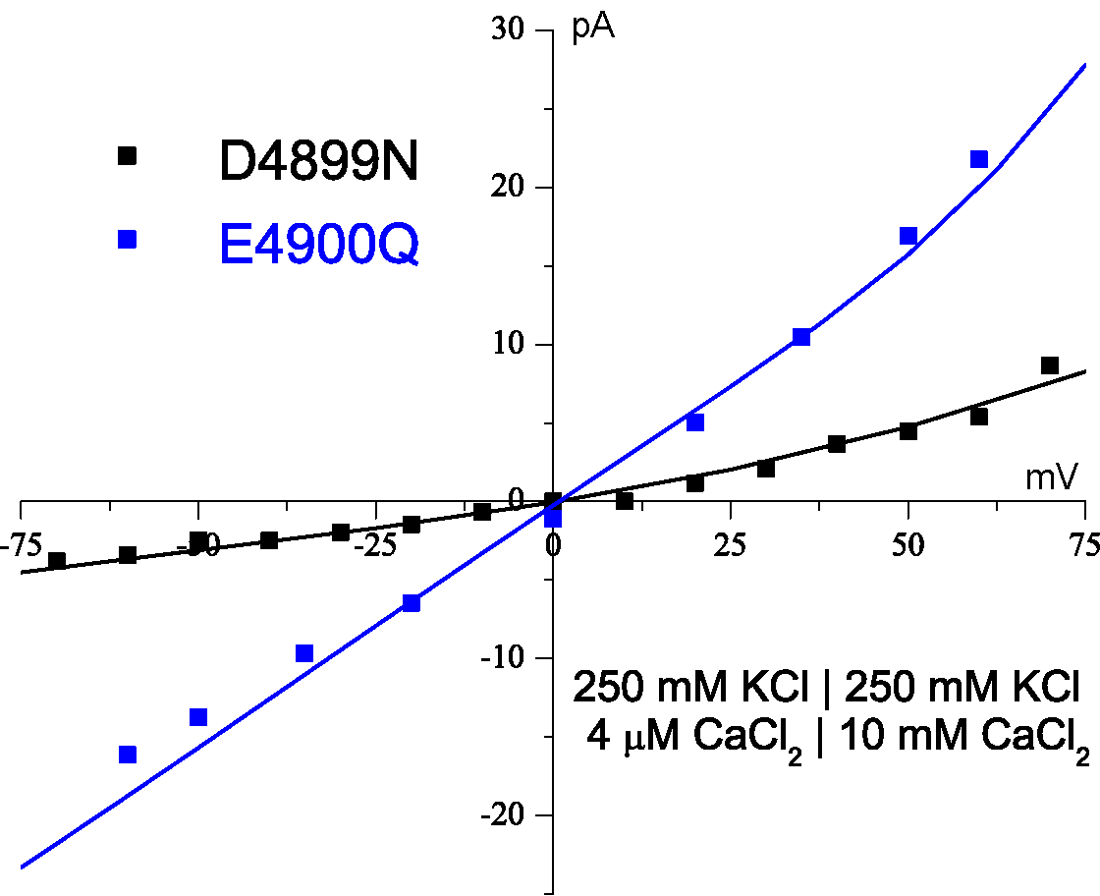
Theory fits Mutation with Zero Charge No parameters adjusted
Theory Fits Mutant in K
Theory Fits Mutant in K + Ca
Error < 0.1 kT/e
1 kT/e
Protein charge density wild type* 13 M
Water is 55 M
*some wild type curves not shown, ‘off the graph’
⇨
0 M in D4899
1 kT/e
Gillespie et al J Phys Chem 109 15598 (2005)

